Slide 1
Mgmt. of Organizational Data
MGMT 58200
1.1

Slide 2
Data
is
Everywhere
Notes:
Name something you have done today that resulted in data being stored.

Slide 3
Example: Loyalty Card Programs
Your actions become data
Retailers collect point-of-sale data from customers in the form of loyalty programs
First-party data – direct from customer to business
Retailers can use that data to create customized discounts or incentives based on past purchase history
Who else might use that data?
Health researchers ✅
Loyalty card data could help spot ovarian cancer cases sooner (The Guardian, 01/26/2023)
Health Insurers 😡
Health Insurers Are Vacuuming Up Details About You — And It Could Raise Your Rates (ProPublica, 07/17/2018)

Slide 4
Data
⬇️
Information
Notes:
Data alone is not enough. We need to transform that data into INFORMATION. And that’s what those researchers and insurers are doing: gathering data and building information about all of us.

Slide 5


Data to Information
Data
Rob went to the grocery store on 8/17/25
Bourbon was purchased on 8/17/25
Information
Rob purchased bourbon on 8/17/25 at the grocery store
Rob purchases bourbon approximately every 60 days

Slide 6
Data
⬇️
Information
⬇️
Insights
Notes:
That information is what we’ll turn into INSIGHTS. Insights give us actionable intelligence that help us make business decisions.

Slide 7
Data to Information to Insights
Data
Rob went to the grocery store on 8/17/25
Bourbon was purchased on 8/17/25
Information
Rob purchased bourbon on 8/17/25 at the grocery store
Rob purchases bourbon approximately every 60 days
Insights
Rob is a regular customer who might be able to be enticed to buy other items
Email a coupon to Rob for $2 off bourbon when he buys soda
Rob is a regular customer who might be incentivized to visit the store more frequently
Send a push message to Rob when bourbon goes on sale

Slide 8
Evolution of Organizational Data
Data
Identification
Collection
Storage
Information
Query
Aggregation
Combination of datasets
Insights
Presentation of results to stakeholders
Review of actionable intelligence (do the business decisions make sense in the context of the data?)
Notes:
But let’s not get ahead of ourselves too much

Slide 9

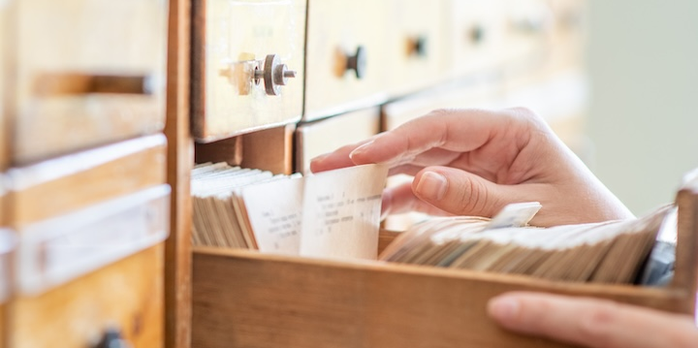


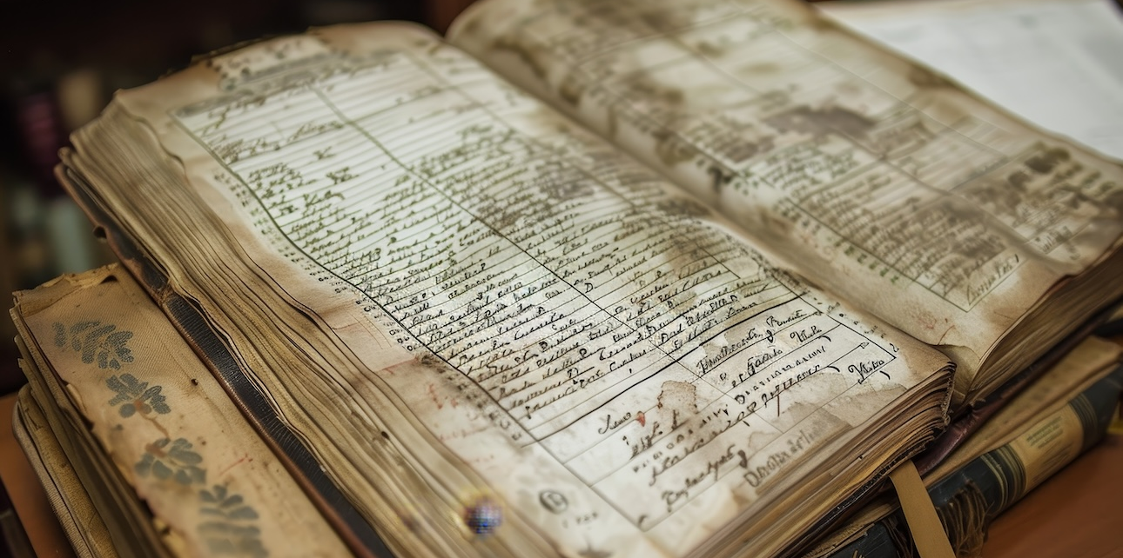
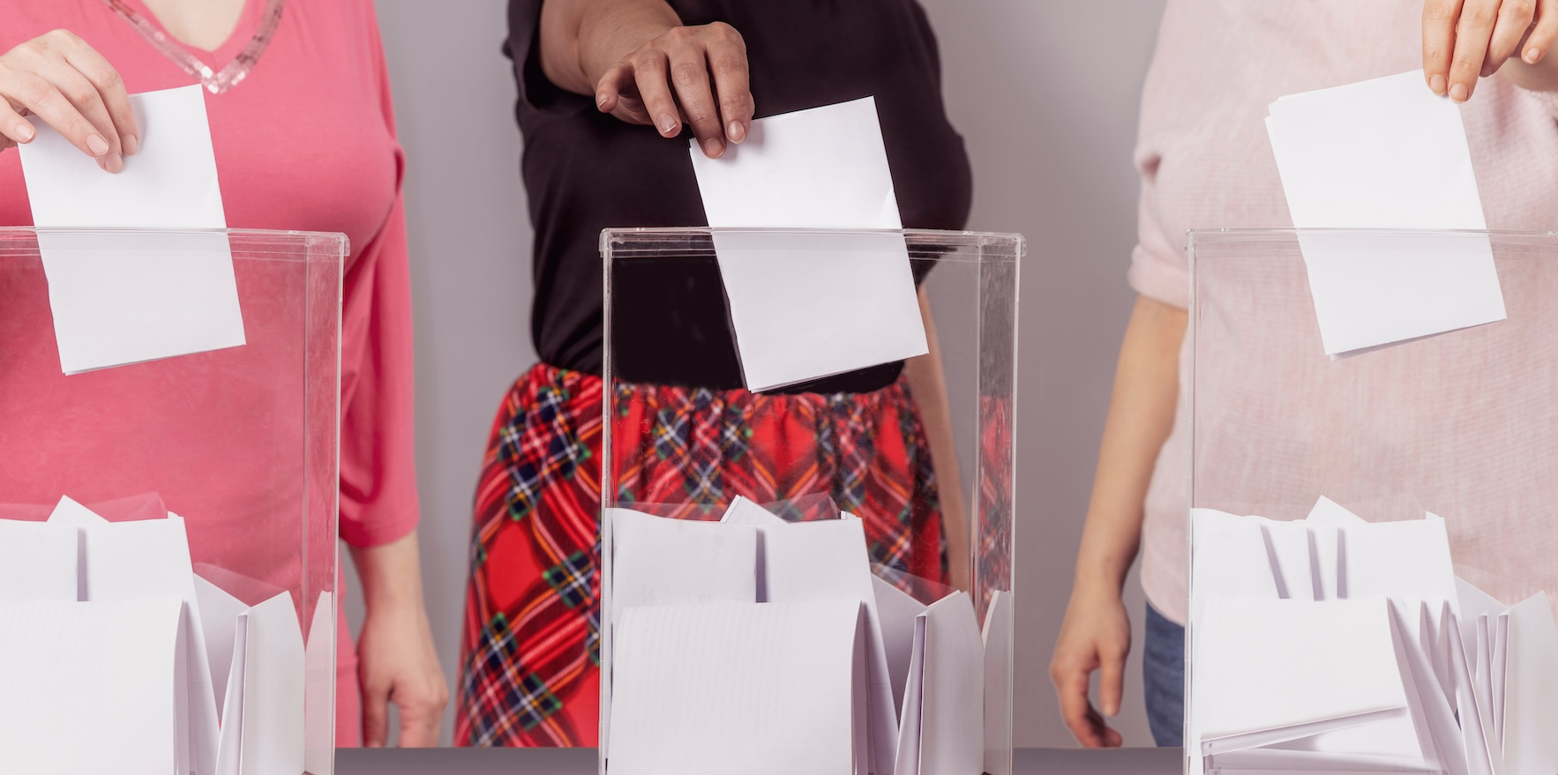
“Database”
Recipe Collection
Library Card Catalog
Rolodex
Address Book
Ledger or Checkbook
Ballot Box
Notes:
The notion of a database isn’t new. We’ve been using them for centuries. But they have evolved.

Slide 10
Types of Databases
MGMT 58200
MGMT 59000 – Advanced Database
Relational
Traditional “database” mindset
Structured data
Records with similar details collected into tables
Multiple tables can be integrated together
Primarily use SQL for interactions
Examples: SQL Server, MySQL
Non-Relational
“NoSQL”
Semi-structured
Documents are grouped into collections
Examples: MongoDB, Firestore, Cassandra, CouchDB
Graph
Objects are stored as nodes
The relationships between nodes contain data as well
Think: social media
Examples: Neo4j, TAO

Slide 11

Where do we begin?

Slide 12

Building a Conceptual Model
Stored data should be reflective of the “real” world
Relational databases are built on the notion of entities
Entities represent structures or concepts within the business or system
Step 1: Discover the entities that are the building blocks of your database

Slide 13
System Description: AudioSphere
AudioSphere is a leading global audio streaming platform that offers millions of songs, podcasts, and videos from artists all around the world. It provides a personalized and interactive music experience with advanced social features, allowing users to discover new music, share tracks, create collaborative playlists, and connect with friends and artists.

Slide 14

Resources for Discovering Entities
Business Documentation
System requests
System descriptions
Proposals
Competitive Analysis
Find and dissect similar products
Interviews with Stakeholders
Should have been done with the systems development process
Stakeholders: inside and outside the organization
Your own lived experience
What have you used?
What have you loved?
What have you hated?

